Slide 1



Attention control training for infants at risk of ADHD
A randomised controlled trial

Slide 2
Why is this research important?
Pharmacological treatments, licensed only for children > 6 years old
Potential of an early cognitive intervention to reduce risk for later ADHD onset

Slide 3
We are currently recruiting babies who are
Less than 11 months old
AND
Have an older sibling/parent with ADHD
(The study will be running until July 2017)

Slide 4
What will happen if I take part?
Families will be asked to visit the Babylab at Birkbeck College
All travel costs to central London will be reimbursed
Eye tracking, EEG, behavioural assessments

Slide 5
Families who want to take part in the trial:
Will be randomised to the intervention or to a control group.
Home based training sessions with two trained researchers
Up to 12, one hour training sessions (once a week)

Slide 6


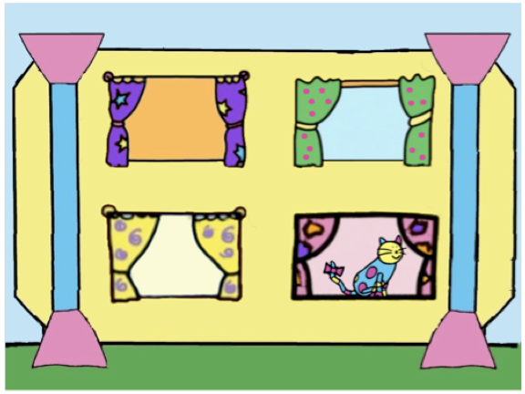


Notes:
Gaze contingent task
Previous research (Wass et al. 2011) demonstrates effectiveness of this intervention to improve attention control in typical 11 month old infants

Slide 7
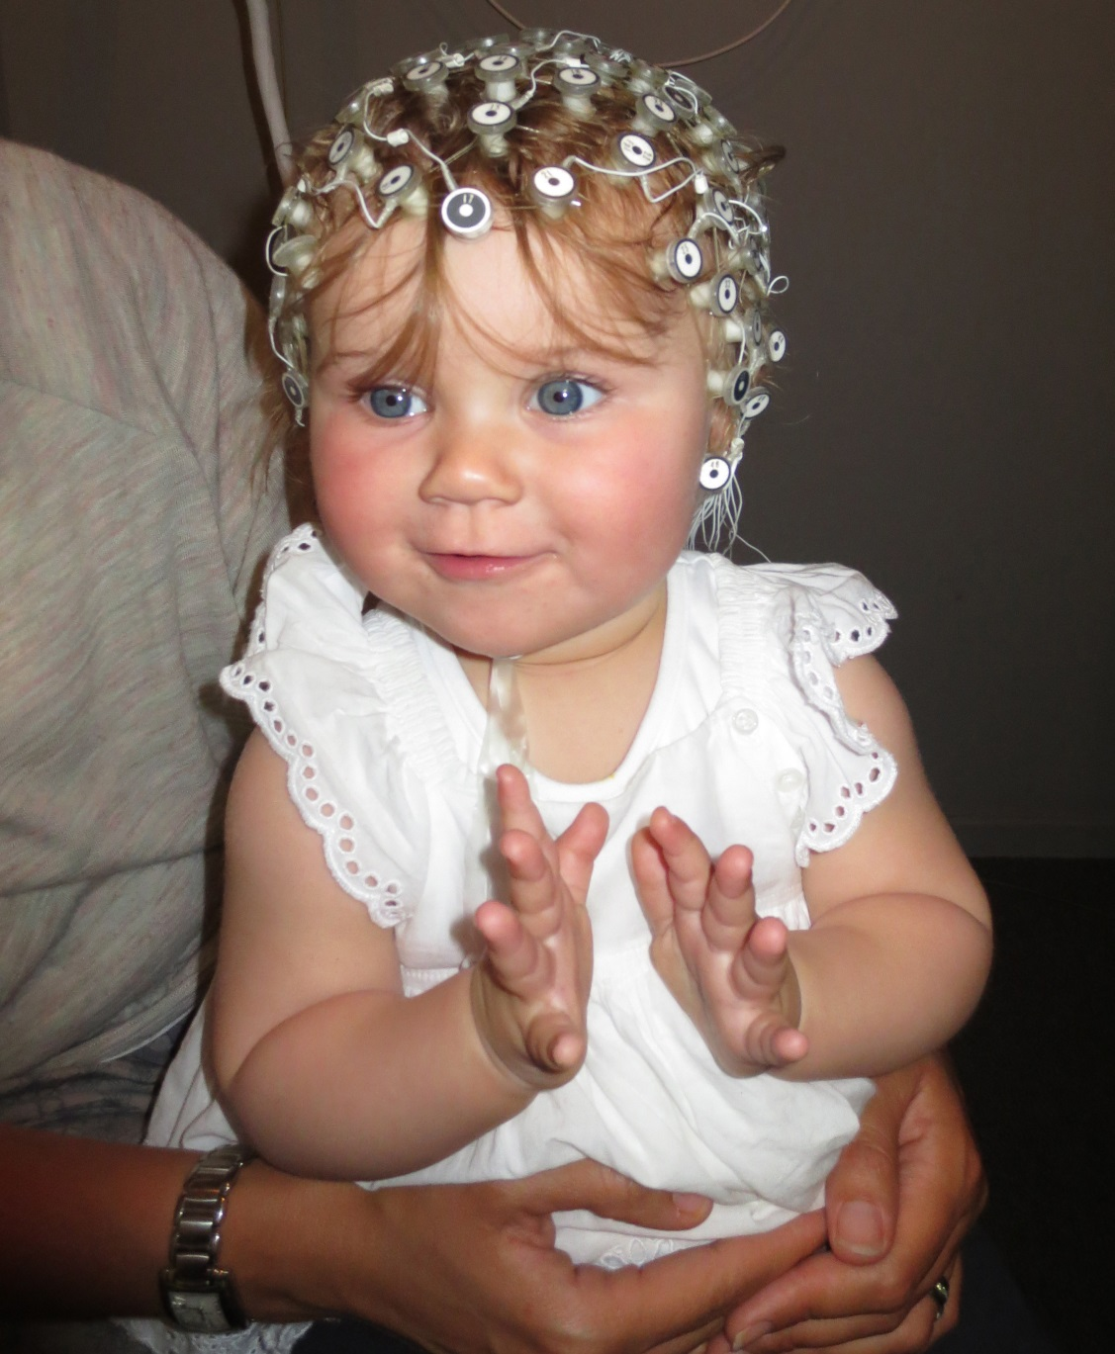
EEG

Slide 8
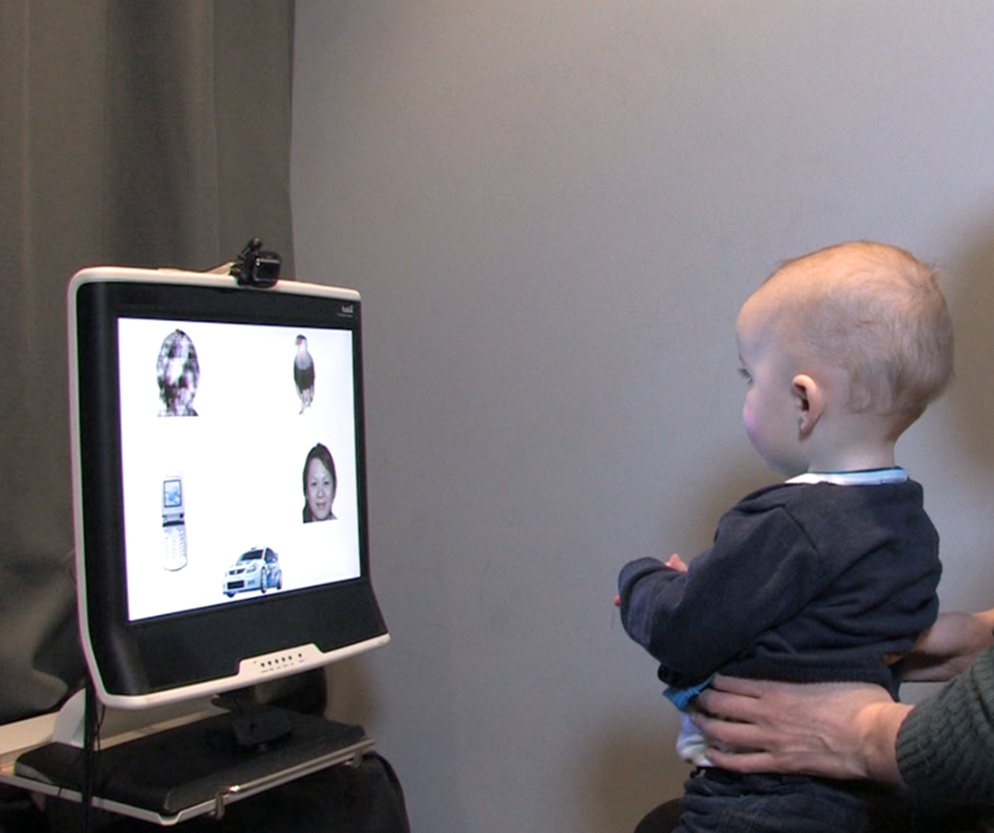
Eye tracking

Slide 9
For further information please contact:
STAARS, The Babylab, Centre for Brain and Cognitive Development
Tel: 020 7079 0761
Email: staars@bbk.ac.uk
Visit us: http://www.staars.org/#!interstaars/cm2a
Or take a leaflet!

