Slide 1
ADHD, Adolescence, Emotion and Relationships
Dr Alex Doig
Consultant Child and Adolescent Psychiatrist
Richmond CAMHS

Slide 2
ADHD, Adolescence, Emotion and Relationships
Assumptions:
  All believe ADHD is a real thing.
  All understand ADHD is a neurodevelopmental disorder (mostly born with it).
Neurotypical Adolescent Development
Emotions and Adolescence – Neurotypical vs ADHD
Specific Conditions: Depression / Anxiety
BREAK
Specific Conditions: PTSD / Adjustment Reactions
What can help
Relationships
ADHD and Relationships
Not going to speak on:
  Brain anatomy in detail
  Treatment of conditions in detail

Slide 3
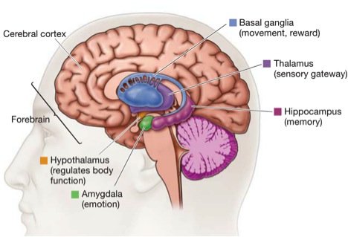
The “Neurotypical” Adolescent Brain
Poor “Brakes”
Control, Planning,
Problem Solving
Great “Accelerator”
Emotion, Impulses, Aggression, Instinct

Slide 4
Emotion
ADHD brains have differences on top of what happens during adolescence
NON-ADHD
ADHD
Moody
Intense
Impulsive
Rebellious leading to independence
Able to self soothe (or use peers)
Able to inhibit urges
Able to self motivate
Mood Swings / Labile
Extreme
Impulsive +
Oppositional but too disorganised to be independent
Struggle to self soothe
Struggle to inhibit urges
Struggle to self motivate

Slide 5
Specific Conditions
Depression
Anxiety
BREAK
PTSD
Adjustment Reaction

Slide 6
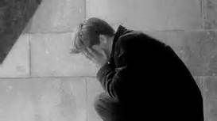
Depression
Sad most of the time, tearful, low
Low energy, poor appetite, disturbed sleep, loss of enjoyment, irritability
Feeling worthless, useless
Loss of hope, future bleak
Suicidal ideas

Slide 7
Depression and ADHD
Depression
  Low Mood majority of the time
  Poor concentration is recent
  Irritability out of character
  Can’t sleep as thoughts negative
ADHD
  Low moods situational
  Poor concentration long term
  Irritability in character
  Can’t sleep as mind / body won’t settle
ADHD with Depression (Co-morbidity)
  Change in behaviour / personality
  Loss of interests / not enjoying things as before
  Moods can be more extreme
  Increased Impulsivity (esp boys) – fights / self harm & overdoses
  Withdrawal (esp girls)

Slide 8
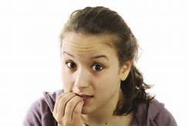
Anxiety
Feeling worried all the time
Heart rate goes fast / breathing fast / feeling sick / dry mouth / shakes
Fight / flight / freeze response
Avoidance

Slide 9
Anxiety and ADHD
Anxiety
  Restlessness since anxiety
  Poor concentration is recent
  Irritability out of character
  Can’t sleep as thoughts worrying
ADHD
  Hyperactivity longstanding
  Poor concentration long term
  Irritability in character
  Can’t sleep as mind / body won’t settle
ADHD with Anxiety (Co-morbidity)
  Change in behaviour / personality
  Avoidance of what makes them scared can be extreme
  Fight / flight can be very literal (increased police contact)
  Increased Impulsivity (esp boys) – fights
  Withdrawal (esp girls)

Slide 10

Break

Slide 11
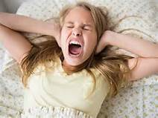
PTSD
(maybe worth briefly discussing attachment disorder)
Associated with trauma and often the fear that life or loved ones at risk
  Dissociation – zoning out with anxiety symptoms
  Flashbacks
  Nightmares
  Jumpy and easily startled
  Anxiety and panic
  Can by hyper-aroused (looks like hyperactivity)
  Can’t concentrate (because of bad memory)

Slide 12
PTSD (and attachment) and ADHD
PTSD / Attachment
  Restlessness since PTSD and associated with flashbacks
  Poor concentration is recent
  Irritability out of character
  Can’t sleep due to nightmares
  Attachment – history of abuse / can’t form relationships well
ADHD
  Hyperactivity longstanding
  Poor concentration long term
  Irritability in character
  Can’t sleep as mind / body won’t settle
  Relationships affected by impulsivity but can form relationships
ADHD with PTSD (Co-morbidity)
  At risk of trauma due to impulsivity (victim and perpetrator)
  Girls (and boys) with adhd at risk of bullying – can lead to PTSD
  Change in behaviour / personality
  Fight / flight can be very literal (increased police contact) but often triggered by flashbacks
  Increased Impulsivity (esp boys) – fights
  Withdrawal (esp girls)

Slide 13
Adjustment Reaction
The development of emotional or behavioural symptoms in reaction to a stressful situation.
  Break ups / bullying / Family difficulties / bad exam results etc
Distress more extreme than that expected considering the trigger
Should resolve within 6 months
Symptoms can be depressive / anxious / behavioural
ADHD more exposed to stressful situations (impulsivity)
Emotional reactions can be more extreme
Impulsivity increases risk (ALL MEDICINES SHOULD BE LOCKED AWAY)

Slide 14
What can be helpful?
Structure, Boundaries
Regular sleep
Exercise
Good nutrition – avoid caffeine / alcohol
Help problem solve peer relationship problems (trigger for depression)
Building on sense of achievement & mastery, build self esteem
Focus on what they do well, positive praise
Problem solve specific triggers – education
Be mindful to keep adult problems with the adults (finances / parental relationships)
Can be helpful to review medication / review treatment plan at CAMHS

Slide 15
Adolescent Relationships
Parents – still supporting financially and practically, but no longer the “parent’s child” and now a person in their own right.
  Natural move away from parents to peer group.
  Challenging of parents ideas / values / beliefs
  Desire to be independent, but not quite ready to be fully independent
Peers – become more important in terms of validation & identity
  Confide in friends rather than parents
  Social world focussed more on peers than parents
Intimate relationships- become more important, exploration of relationships, sexuality, sexual behaviour,

Slide 16
ADHD Relationships
Parents – Kids with ADHD can be less mature, but still want independence.
  Impulsive acts can worry parents more.
  Normal rebellion can seem extreme.
Peers – can be excluded from peer group due to ADHD.
  Can have more arguments, fall out more often.
  Can pick challenging peer group – use of drugs as self medication / impulsive use
Relationships – can be too quick to declare undying love
  Quick to fall out – and get back together
  Other half may struggle with rapid mood states.
  More likely to use sex as “self medication” – increases self esteem, can think it will improve social standing, BUT….less likely to use safe sex

Slide 17

Safe Sex
Think Contraception
  For girls think longer term contraception that you don’t need to remember.
  For boys, talk about using condoms, teach how to use
  http://www.gettingiton.org.uk/

Slide 18

Questions?

