Slide 1


Behaviour Analysis and ADHD
What behaviour means and its value to the individual
Andrew Swartfigure, BCBA
Head of the Peartree Centre

Slide 2
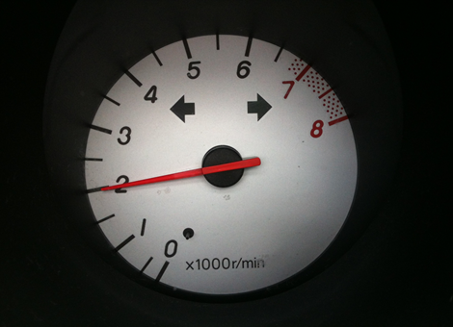

What do you see?

Slide 3
Our areas tonight
Warning- we’re interactive tonight!
Relevance of ADHD
Behaviour
Functions
Case study- a chance to analyse behaviour
Value
Translation

Slide 4
Does ADHD matter?
Short answer…
Long answer… we are all human and live in and experience the environment… just differently;
Perhaps its just the needs we need to address

Slide 5
Behaviour
“Everything that we do”
The ends are justified
What about the means?

Slide 6
General approach
What do you do if you think child is trying to gain attention (inappropriately)?
Factors to consider: (in groups)
Where is the child when they are trying to get attention?
Is gaining attention ok?
How does the child gain attention?
What other ways can they gain attention?
What capacity is the child operating at: where is their rev counter?

Slide 7
Functions
Brian Iwata
Sensory
Escape
Attention
Tangible
Just ADHD or other SEN?
These are the top level functions for all of us

Slide 8
A quick note
Reinforcement: defined as increasing the likelihood a behaviour will happen again in the future

Slide 9
Case study: Sam
Profile:
8 years old, been in mainstream education since Reception class, hitting peers and rule breaking started at beginning of academic year
AR report and the STAR documents are indicative of a possible ADHD profile
Impulsive behaviour incidents, poor reaction to a competitive situation
The consequences of his behaviour seem to get him access to 1:1 attention

Slide 10
Intervention- best intention
Currently attends a social skills group twice a week, he is the most attentive and participates more than the other children
Children discuss 8 rules of appropriate play and cooperation
Children explore “how does my engine run”
Children participate in “Social Detectives” programme

Slide 11
and yet…
Increased incidents of aggressive play
Increased incidents of “rule breaking” in the playground
Regular withdrawal from the playground, considered “time out”: TA takes him into the classroom
Why are things increasing? (groups)

Slide 12
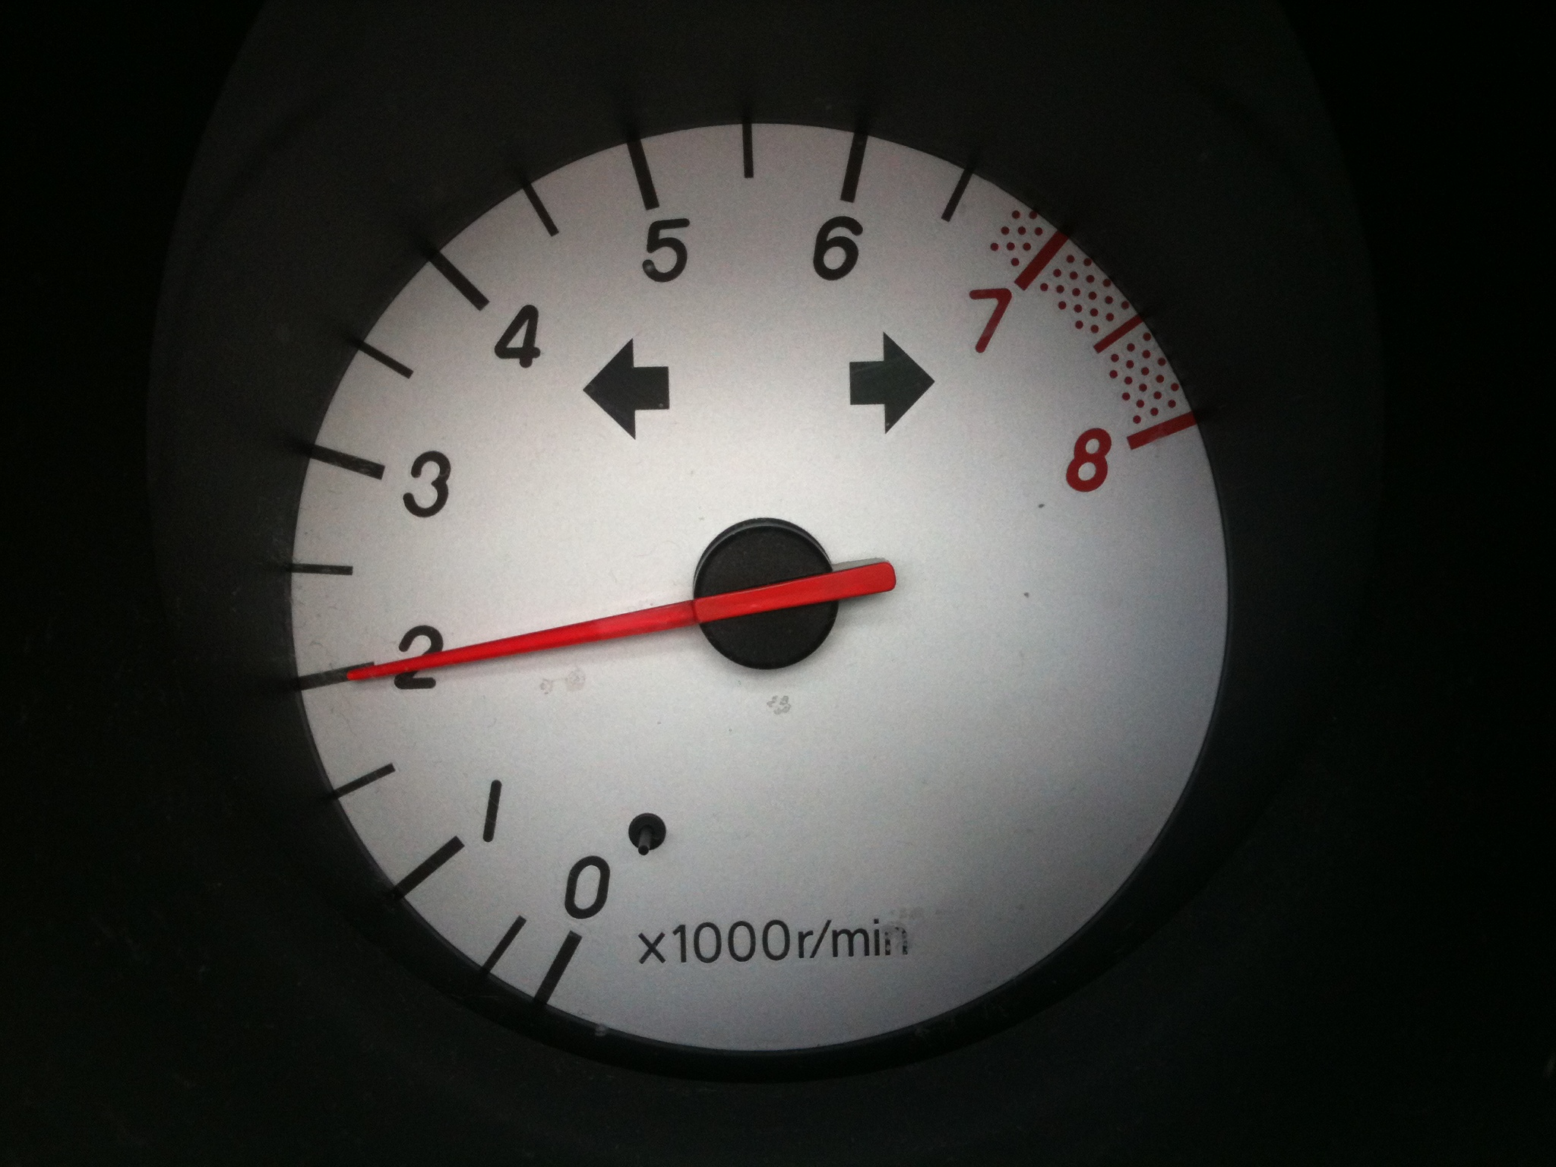

An appropriate intervention
Self Management strategies

Slide 13
Behaviour and its Value
Matching Law
B1= V1
B2= V2

Slide 14
Your turn
Based on what we know and in groups:
Discuss a strategy you could use considering Value of
Behaviour and reinforcement
Key questions I am going to ask you:
How?
Why?

Slide 15
Intervention related to function- a behavioural contract
Proactive: establish a set of abridged, 3-4 rules or contract with Sam that he follows during playtimes (these should relate to the Intervention group content if relevant)
Rules are clearly observable behaviours e.g. “use your words to tell your friends if they are upsetting you” rather than “play nicely with your friends”
Establish with him what he will get/ have access to if he holds up his end of the contract e.g. time alone for five minutes, time on a computer etc.
It must directly follow a successful playtime - every time

Slide 16
Doesn’t quite make it
Necessarily if he isn’t successful then he doesn’t access these things, but in each instance after a play time he gets a chance to go through the contract to see if rules have been achieved.
The thing/ activity that he has established pre- playtime are not used as a threat in terms of ‘you won’t get it if you hit’ moreover state the positive behaviours.

Slide 17
Hints and tips
Establishing the length of the contract is important, you can do this a number of ways:
You could state it is for the whole of play time
Staff can think about the average amount of time it takes for him to become likely overwhelmed
Set the interval for the contract to be slightly below this time to give the best chance of success
He may be able to tell you how long, but bear in mind that if he is competitive this may be overstated.

Slide 18

Translation

Slide 19
Impact of ADHD
The behaviours he demonstrated are not necessarily in line with the rest of his profile, so their contrast is significant to those around him- however they do represent a need.
This ‘need’ manifest as a lack of coping in busy or competitive environments, where he can broadly function at capacity but anything additional that he has to cope with can cause him to act impulsively.
If you analyse the consequences of his actions, they seem to be escaping from these situations and or access to a 1:1 staff. Neither of these are inappropriate, yet his means are the crux of the matter.
Speculatively: if you look at his ability to articulate and or access the content of the Intervention time, there was an obvious contrast i.e. in a safe, structured environment that is adult led, his capacity was not so full and therefore he is capable of demonstrating and talking about the right things to do etc.
In other words he may be able to deal with a structured literal environment but when boundaries are ‘unknown’ or the reaction or interaction with his peers is ‘unpredictable’ he may be overwhelmed.

Slide 20
In summary
Intervention with the best intention vs. functional assessment
This is only one child, with one function, related to one environment
Functional assessment is key
There is not one size fits all
Ask yourself why something is happening; NOT WHAT
Value to the individual

Slide 21


a.swartfigure@stanley.richmond.sch.uk

