Slide 1
So You Think your child has ADHD – what to Do now!
Dr Claire Scott
Consultant Paediatrician
https://www.developmental-paediatrics.co.uk

Slide 2

DON’T PANIC!

Slide 3

ADDISS
http://www.addiss.co.uk
Notes:
Handbook! All you need

Slide 4
WHO TO GO TO?
Independent Support – Local and National
Education Charities – Local and National
  Advice & Support Services Network http://cyp.iassnetwork.org.uk
  Parent Partnership Services Network
  Special Educational Needs and Disability Information Advice and Support Service – SENDIASS
  Richmond - https://www.kids.org.uk/richmond-and-kingston-sendiass
  ‘LOCAL OFFER’ for parent support strategies / courses such as 1,2,3 Magic

Slide 5
WHO TO GO TO?
GP
SCHOOL - SENCo and Educational Psychologist and School Nurse
OTHER PROFESSIONALS WHO KNOW YOUR CHILD
‘LOCAL OFFER’ for parent support strategies
SINGLE POINT OF ACCESS to request help with behaviour or request assessment

Slide 6
WHAT TO DO
Occupational therapy – school / GP can refer
Educational Psychology assessment
Omega - 3
Notes:
ADHD RICHMOND
ME TO & CO
ADDISS
SENSORY PROFILE
VISUAL INTEGRATION
CORE STRENGTH

Slide 7
How to avoid A Rejected Referral!
Good information!
Parents and School
Impact on child and family
What strategies have been tried!
Notes:
AFTER SCHOOL CLUB
CHILD MINDER
EXTERNAL CLUBS
MUSIC TEACHER
HOLIDAY CLUBS

Slide 8
EDUCATION
Notes:
I have many referrals via school
Push back – Strategies – Mov ‘n’ sit cushion blue tack, Fiddle toys
Understanding
All to easy to request increase in medication
OT – school can request.
Ed pscyc

Slide 9
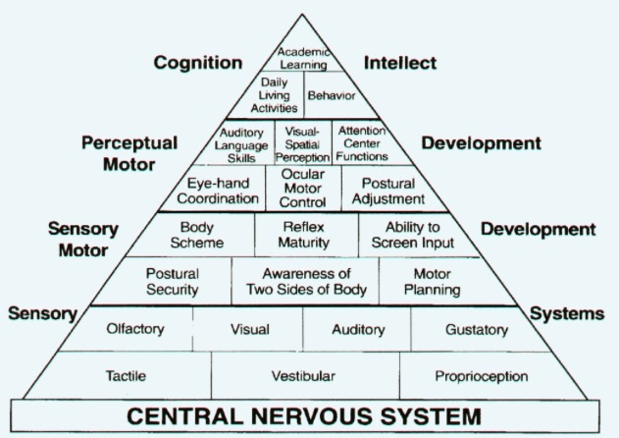
Pyramid of Learning

Slide 10
SEN CODE OF PRACTICE

Slide 11
NICE GUIDLELINES
Notes:
Many families I see VERY resistant to medication
How many of your children have seen an OT?
Filled out a sensory proflle
Yet recommendations are Mov ‘n’ sit cushion
Fiddle toy
OT not in NICE guidelines

Slide 12
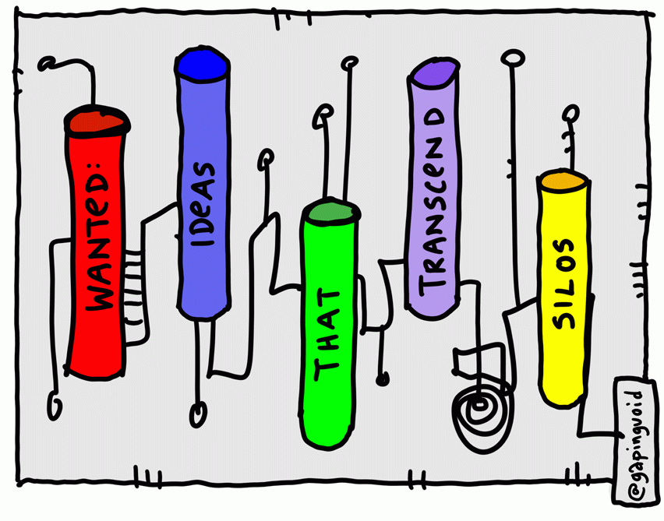
SILO WORKING

Slide 13


Slide 14

Notes:
SOLUTIONS!

Slide 15
Information Sharing
Notes:
KEY
PROMPT AND PROMOTE

Slide 16
Is it ADHD?
What else could it be?

Slide 17


Slide 18


Slide 19
Diagnosis
Joining it together
Notes:
Diagnosis based mostly on Subjective assessment

Slide 20
Co-Morbidities
What are they?
Every Child is Unique

Slide 21
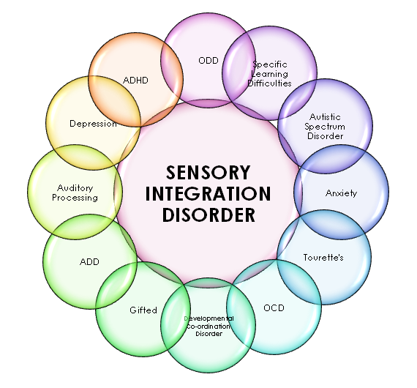
Notes:
We all have traits of something
Many neurodevelopmental conditions can often exist together, but each can be treated in different ways.

Slide 22
Pyramid of Learning

Slide 23
AUTISTIC SPECTRUM DISORDER
Notes:
Attention
ASD – hypervigilant attention and internal distractability
ADHD – lack of focus and and distractability by external stimuli
Executive Functioning
ASD Display preservation of conscious inhibitory function but with quite severe problems planning and shifting attention
ADHD Display difficulties on tasks measuring inhibition and sustained attention while remaining relatively unaffected on tasks measuring planning or cognitive function.
ADHD can have issues with socialisation and self esteem

Slide 24
Developmental Co-ordination Disorder
(DCD)
“DAMP”
Deficits in attention and Motor Perception
Notes:
DCD – dyspraxia is the old term
Also used for Ed Psychs?
Closely associated
Seen as separate in DSM – V
Diagnostic Statistical Manual of Mental Disorders

Slide 25
Learning Difficulties
Visual and Auditory Processing
Working Memory
Processing Speed
Notes:
Has anyone heard of this – had their child assessed?
British Association of Behavioural optometrists http://babo.co.uk
Children are usually born with the necessary hardware to allow the development of normal sensory skills, but it takes a busy childhood of play, exploration and experience to develop and train the software that controls what we take in from the world. If this software is not established properly, it can result in problems with the visual system and therefore learning. If undetected these problems can continue into adulthood.
Ability to derive meaning and direct actions from what is seen as triggered by the process of light entering the eye and impinging on the retina.
It explores and and examines how the visual input at the eye is dealt with in the brain and how it integrates with the other brain processes e.g. hearing, movement and touch etc

Slide 26
EnvironmentAL Factors
Auditory Processing Disorder
Notes:
Children that are far worse in busy situations e.g school.
APD – all children ignore you.
Therefore need info from more than one setting

Slide 27
Other Co-mordities
Poor sleep pattern / disorder
PTSD
OCD
Oppositional Defiant and Conduct Disorder
Anxiety / depression
Epilepsy
Intellectual Disability
Undiagnosed medical issues – thyroid dysfunction
Psychosocial – Adverse Childhood Experience
Notes:
Psychosocial – family dysfunction / attachment difficulties Child Abuse ACE
Can be hard to differentiate due to developmental level

Slide 28
Girls and Women With
ADHD
Same but Different!

Slide 29
Women and Girls with ADHD
Prevalence – much less 1:4
Atypical Presentation
Hormone mediated later onset
Referral bias
Often misdiagnosed
Co-morbidity difficulty to assess
Recognised by NICE guidelines
Notes:
Many girls remain undiagnosed as they tend to be less disruptive. But while they may not be referred to a clinic, they may still be failing at school1 and experiencing other problems due to their ADHD. ADHD in girls (who have ADHD with hyperactivity, either combined type or hyperactive type), is associated with more severe cognitive and language problems and greater social and emotional health problems.6
Can be much harder to diagnose
Different presentation as with other co-morbidities such as ASD
NICE GUIDELINES ‘underdiagnosis in women and girls who very often get missed

Slide 30
Women and Girls with ADHD
Shy silent and withdrawn at school
Worry about friends and school a lot
Forgetful, poorly organised and worry about school work
Daydream and easily distracted and struggle to stay on task

Slide 31
Women and Girls with ADHD
Physically active, competitive and participate in risky behaviour
Defiant and Aggressive
Disorganised, messy handwriting and struggle to finish tasks
Co-operative at home and try to please at school
Act first and think later, not realising the consequences

Slide 32
Women and Girls with ADHD
Hyperactivity, impulsive and inattentive
Talk too much and restless
At school interrupt others, constantly talking and switch topics
Disorganised
Hyper – social, over sensitive and quick to anger

Slide 33
Resources
1,2,3 Magic
The Out of Sync Child and the Out of Sync Child has fun by Carol Stock Kranowitz
The Incredible Five Point Scale www.5pointscale.com)
Zones of regulation (www.zonesofregulation.com)
Smart but Scattered: The Revolutionary "Executive Skills" Approach to Helping Kids Reach Their Potential
by Peg Dawson and Richard Guare

Slide 35
Summary
Seek help from all sources that you can
Gather good information and encourage information to be shared
All children and young people unique but they can all be helped
Knowledge is power!

