Slide 1

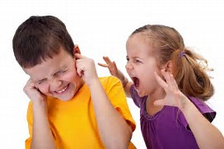
ADHD and Sibling Rivalry
By Laura Kerbey

Slide 2
What we are talking about today:
The impact of ADHD on siblings
Coping with behaviour that challenges the family
Building Resilience
Where to find support

Slide 3
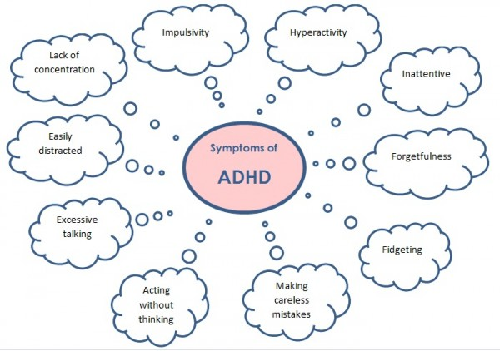
The Impact of ADHD on Siblings
ADHD has a significant impact on the siblings of children who have the condition. One study found that 10 of the 13 siblings (brothers and sisters) interviewed thought they were “severely and negatively” affected by living with a sibling who had ADHD. (www.vmc.com)

Slide 4
The Impact of ADHD on Siblings:
Siblings impacted by behaviour such as:
Physical and verbal aggression,
Out-of-control hyperactivity,
Emotional and social immaturity,
Academic underachievement and learning problems,
Family conflicts,
Poor peer relationships
Difficult relationships with extended family.

Slide 5
Further impact of ADHD on siblings
Siblings described their family life as “chaotic”, “exhausting”, and “focused on their sibling”.
Siblings described “never knowing what to expect next” and that they did not expect an end point to the impact of ADHD on their lives.
Siblings of children with ADHD experienced the disruptive effects of the condition in three ways: victimisation, caretaking and feelings of sorrow and loss.
Siblings reported feeling victimised through physical violence, verbal aggression and manipulative and controlling behaviour.
Many siblings felt unprotected by their parents who were perceived as too exhausted or overwhelmed to intervene.
So - THIS SOUNDS FAMILIAR TO YOU – YOU ARE NOT ALONE!

Slide 6
What it feels like to have a brother with ADHD
When he gets told to do something he always negotiates
He goes so over the top!
He doesn’t go to bed!
He’s embarrassing sometimes!

Slide 7
What it feels like to have a brother with ADHD
He has a lot of energy.
He is loyal and looks after me.
He is very funny!

Slide 8
Supporting Siblings:
Where possible teach about ADHD. “Can I tell you about ADHD by Susan Yarney” is a great book for children to read as is “Dogs have ADHD.”
Talk about famous people with ADHD.
Make sure that siblings also understand that ADHD is not a choice and is a condition. Use an Iceberg diagram to explain behaviour and triggers.
Teach siblings some basic strategies like giving their siblings space, explaining their feelings etc. Role play doing this.
Praise and recognise the efforts siblings go to.
Catch your children being good.

Slide 9
Supporting Siblings:
Use empathy not sympathy to support siblings.
Encourage activities that can be done together.
Always use reward systems for all children
Use a Family Reward Jar
Make sure siblings get time with you on your own – even if it is just time to talk.
Love bomb!

Slide 10
Coping with behaviour that challenges the family:
Always think of meltdowns as PANIC ATTACKS. This will make you far more sympathetic and more likely to look for solutions.
You don’t have to do everything as a family unit all the time.
Pick your battles! Don’t make promises you can’t keep or threats you won’t carry out.
Flexible boundaries, structure and routine can help manage anxiety.
Consider why the behaviour is challenging you.
Take time out to manage your own stress and anxieties.
Remember you are a role model to your children.
Have an exit strategy – for both the child with ADHD and their siblings.
Use scaling systems to help understand and express emotions.

Slide 11

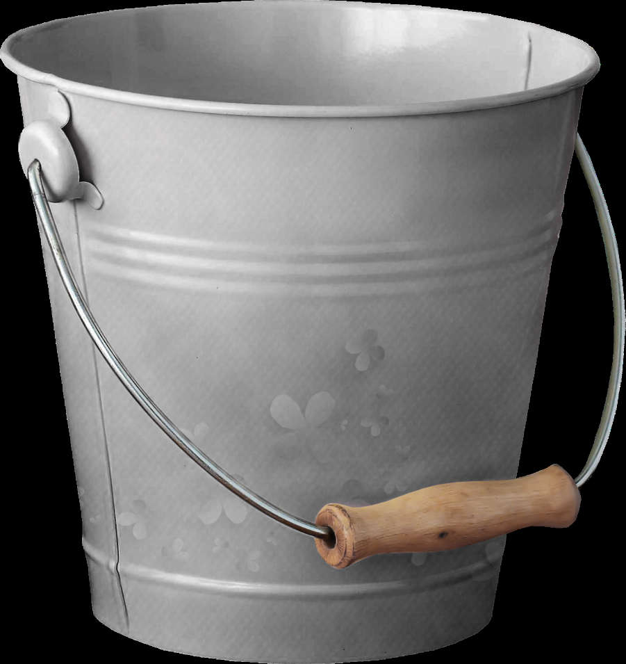
Remember the Anxiety / Sensory Bucket Analogy:

Slide 12

And the Boiled Kettle Analogy Too!

Slide 13

What is Resilience?

Slide 14
Top Ten Tips
Plan ahead for trips etc.
Remember your know your family better than anyone else.
Be confident in your abilities - you are doing a brilliant job!
You can only do your best and your best will always be good enough.
You will have good days and bad days. Take each day as it comes.
Focus on what went well and view mistakes as learning opportunities.
Pick your battles.
Facts are worth more than opinions.
Trust your instincts.
Remember - it will be alright in the end and if its not alright its not the end!

Slide 15
Where to find support:
Find local support groups.
The Local Offer in your area.
Facebook groups.
SEND Bloggers.
YouTube has some brilliant videos on ADHD that siblings can watch.
Other parents.

Slide 16
Thank you for listening
Any questions?
www.positiveautismsupportandtraining.co.uk

